Slide 1
Graph Theory: The “Mathematics” of Networks
Fall 2019

Slide 2
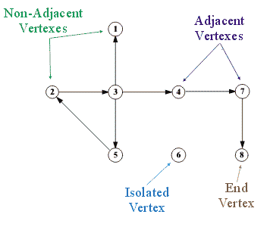
What is a graph?
A graph (G) is an abstract mathematical object
A graph consists of:
  A set of V vertices V(G)
    {v₁, v₂, v₃, v₄, v₅, v₆, v₇}
      Also called nodes, actors, individuals
  A set of E edges, E(G)
    {v₁v₂, v₂v₃, v₂v₄, v₄v₅, v₄v₆, v₆v₇}
      Also called links, ties, relations
  Such that G = (V, E)

Slide 3
What is a graph?
The cardinality (size) of the set V is usually denoted by N
  This is the order of the graph
The cardinality of the set E is usually denoted by M
  The size of the graph is the maximum number of possible edges: (N(N-1))/2
  The density (d) of the graph is the ratio of the observed to the maximum number of edges
  A complete (all vertices joined by an edge) graph has d = 1

Slide 4

What is a graph?
Two vertices in the same graph may be joined by an edge, in which case, they are adjacent
  Adjacent vertices are also called neighbors
Graphs can either be undirected and directed
  In directed graphs edges have a direction
    {v₁v₂} can exist but not {v₂v₁} and are called arcs
  In undirected graphs a single edge connects two vertices
    {v₁v₂} = {v₂v₁}

Slide 5
What is a matrix?
A matrix a rectangular array of numbers arranged in rows and columns
  Matrices can be used to represent graphs
    Vertices are arranged in the rows (i) and columns (j) of the matrix
  Simple graphs result in “square” matrices of dimensions N X N
    Where N = V
    The number of vertices in the graph

Slide 6
What is a matrix?
A matrix is a rectangular array of numbers arranged in rows and columns
  Matrices can be used to represent graphs
    Vertices are arranged in the rows (i) and columns (j) of the matrix
  If an edge exists linking vertex i and vertex j in the graph
    We put a “1” in the ij^{th} cell of matrix A
  Otherwise,
    We put a “0” in the ij^{th} cell

Slide 7
What is a matrix?
A matrix is a rectangular array of numbers arranged in rows and columns
  Matrices can be used to represent graphs
    Vertices are arranged in the rows (i) and columns (j) of the matrix
  More formally,
    x_{ij} = 1, if {v_{i}v_{j}} can be found in E
    x_{ij} = 0 if {v_{i}v_{j}} cannot be found in E

Slide 8
What is a matrix?
A matrix is a rectangular array of numbers arranged in rows and columns
  Matrices can be used to represent graphs
    Vertices are arranged in the rows (i) and columns (j) of the matrix
  Matrices can be used to represent either directed or undirected graphs
    Undirected graphs result in symmetric adjacency matrices
    Digraphs result in asymmetric adjacency matrices

Slide 9
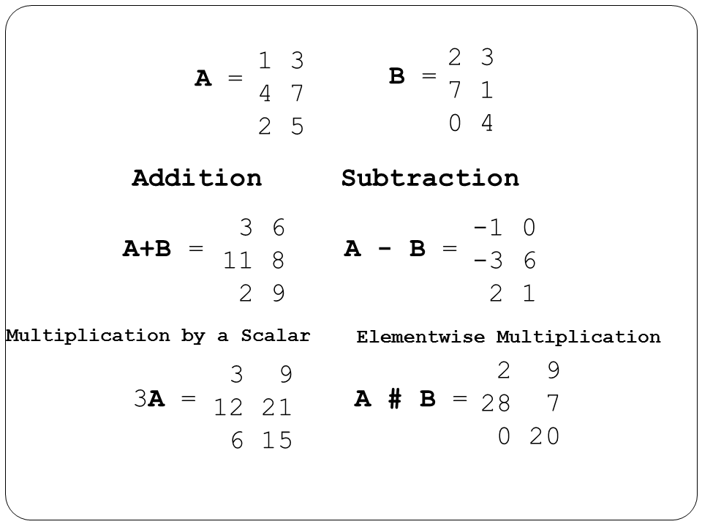
What is a matrix?
A matrix is a rectangular array of numbers arranged in rows and columns
  The main advantage of matrices is that you can do simple mathematical operations on them
    Addition
    Multiplication
    Subtraction

Slide 10
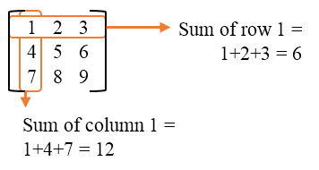
What is a matrix?
A matrix a rectangular array of numbers arranged in rows and columns
  The main advantage of matrices is that you can do simple mathematical operations on them
    Row sums
    Column sums
  This creates measures of graph theoretic concepts!

Slide 11
Networks & Graphs
A graph is a mathematical object G = {V,E}
To represent a network as a graph and associated adjacency matrix you need to define:
  what the vertices (V) are
  what a relation (edge, E) is between vertices.
Then you need to operationalize the definitions by
  Boundary conditions for the V
  Measurement protocol for determining E (social ties)
Data Collection with measurement of presence/absence of a tie

Slide 12
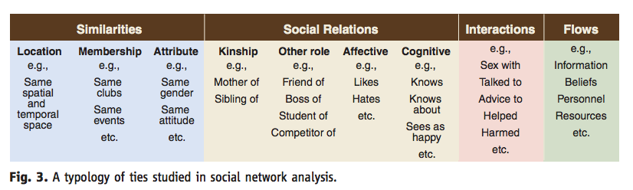
Defining the Relationship: Tie Typology

Slide 13
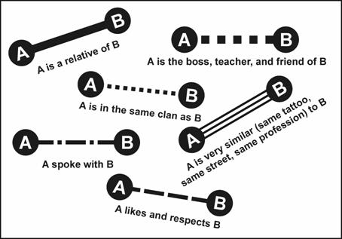
Defining the Relationship: Dyad Types
Dyad is a pair of two vertices: {i,j}
  Directed (digraph): ordered pair {i,j}
  Unidirected: unordered pair
Edge defined by type of a relationship
  Symmetric relationships (friendship, alliance)
  Asymmetric: Can be reciprocal but may not be (liking, advising)
  Antisymmetric: can not be reciprocal (boss, father-son)

Slide 14
Dyad Census
Symmetrical Relationship
Asymmetrical Relationship
Symmetric
Mutual
Null
Asymmetric
Null

Slide 15
Formalization & Representations
x_{ij} = 1 if an edge between i and j
x_{ij} = 0 if no edge between i and j
Digraph (directed) x_{ij} ≠ x_{ji}
Graph (undirected) x_{ij} = x_{ji}
Three Representations
N x N adjacency matrix
Plot (Graph)
Edge List

Slide 16
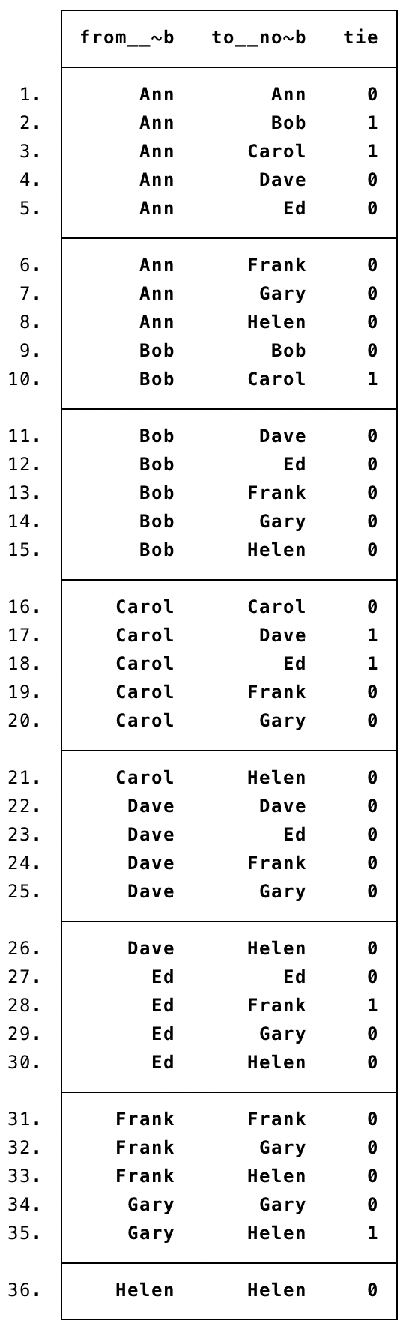
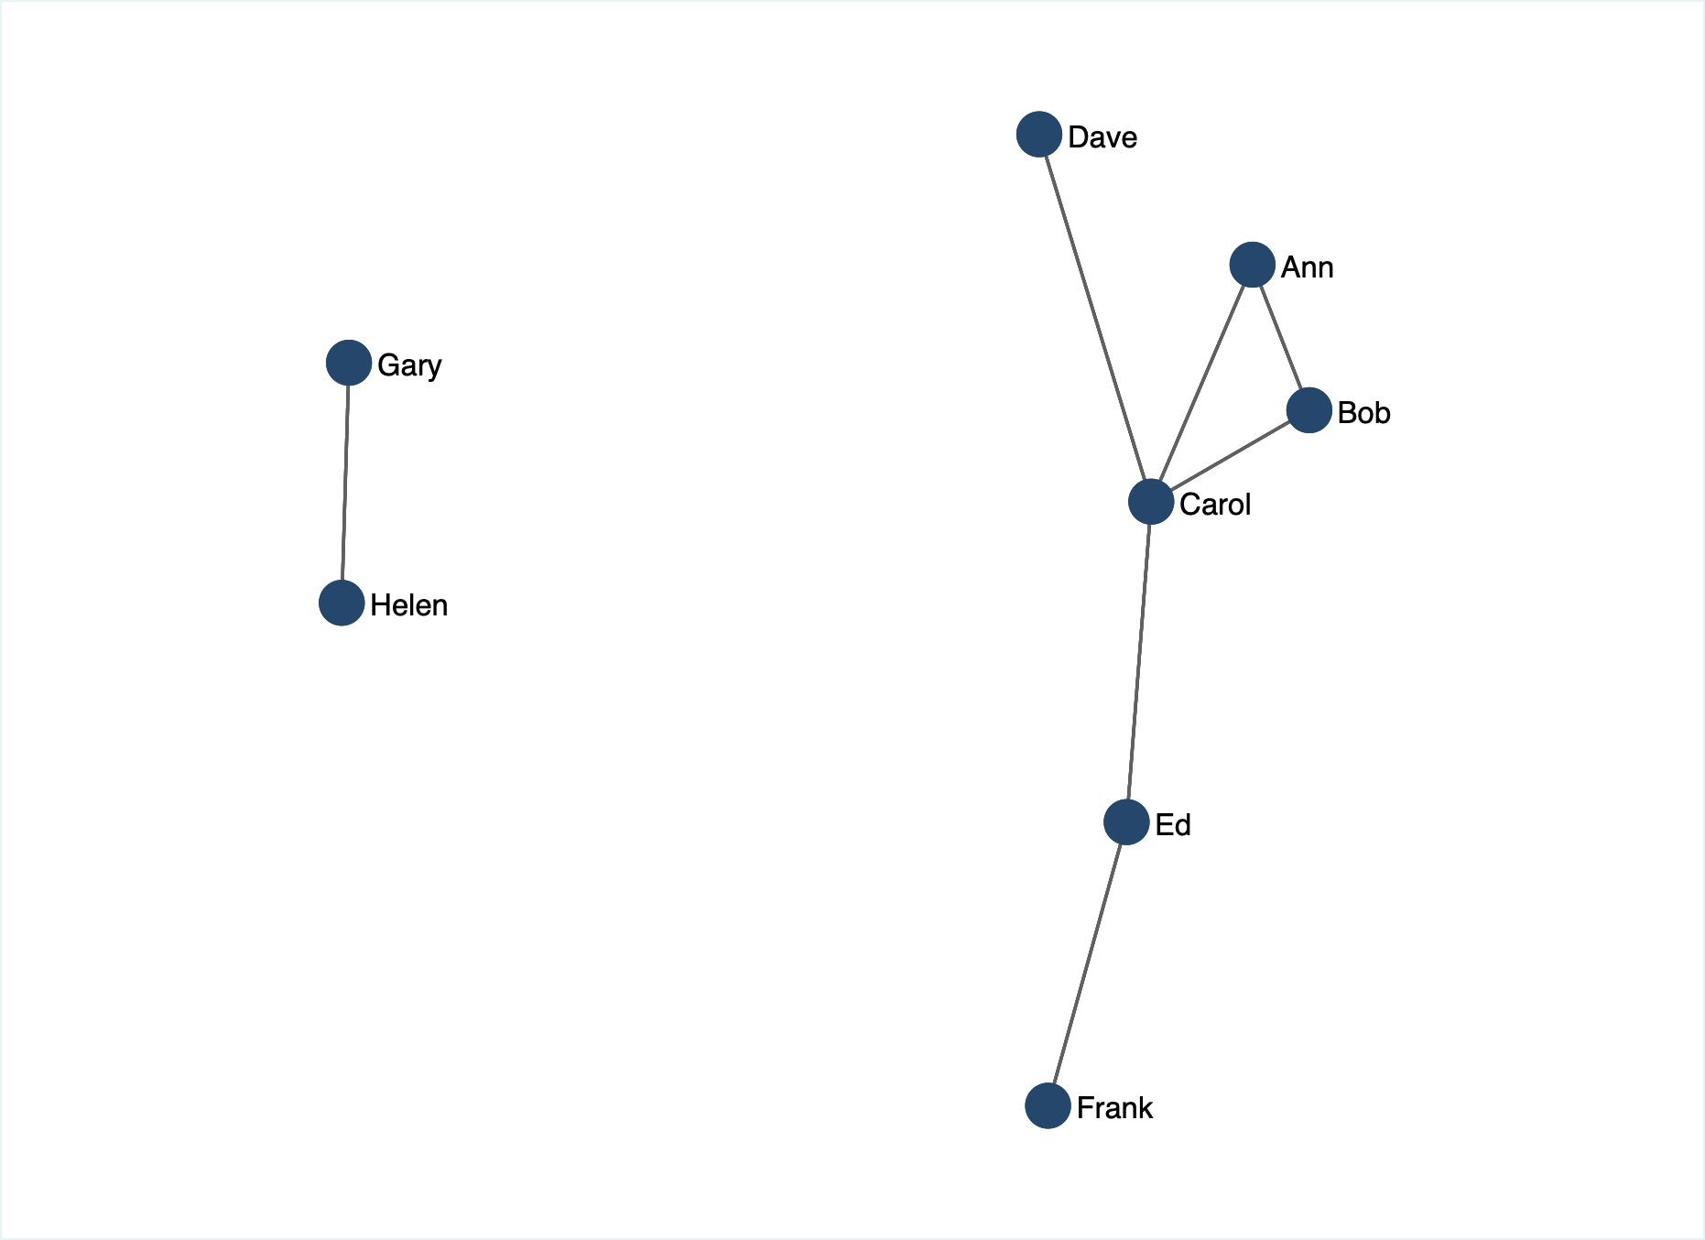
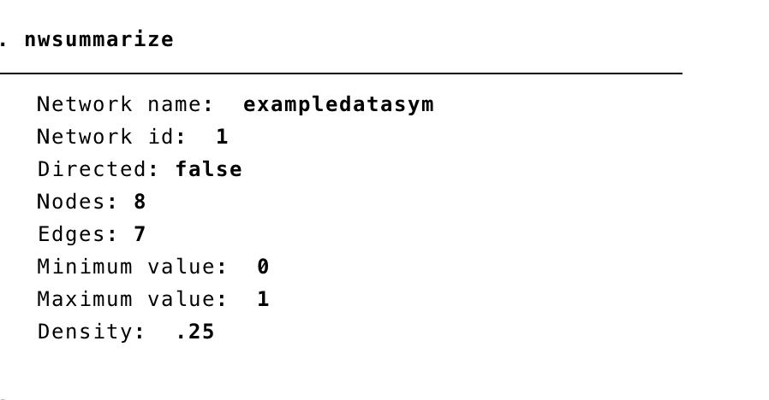
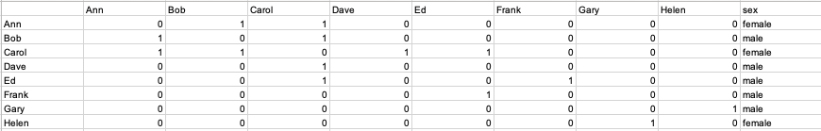
Undirected Graph, Symmetric Matrix

Slide 17
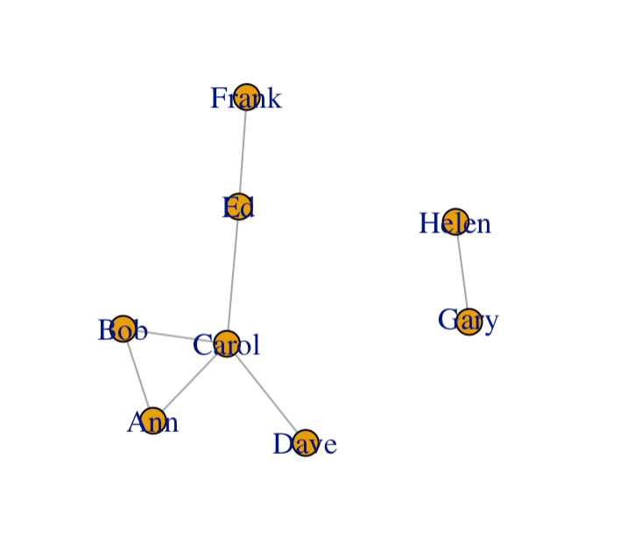
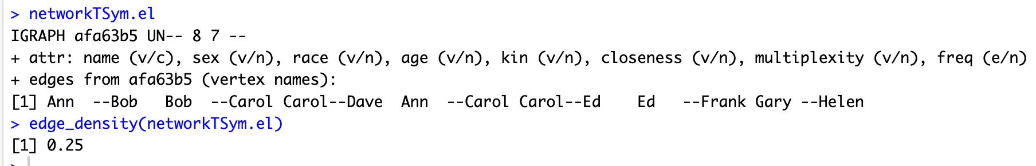
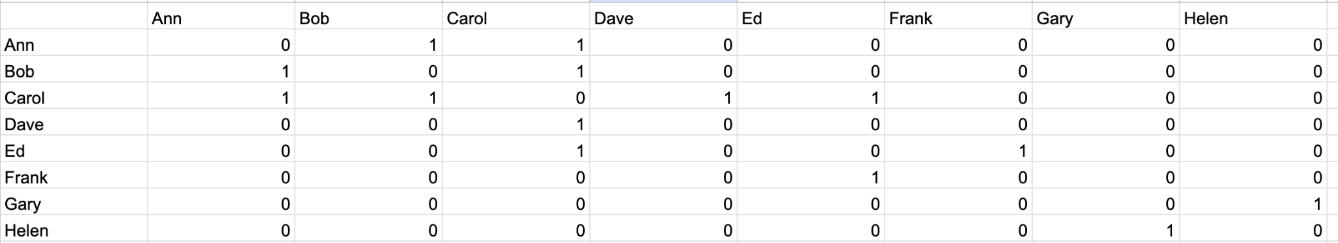
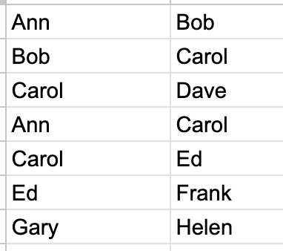
Undirected Graph, Symmetric Matrix

Slide 18
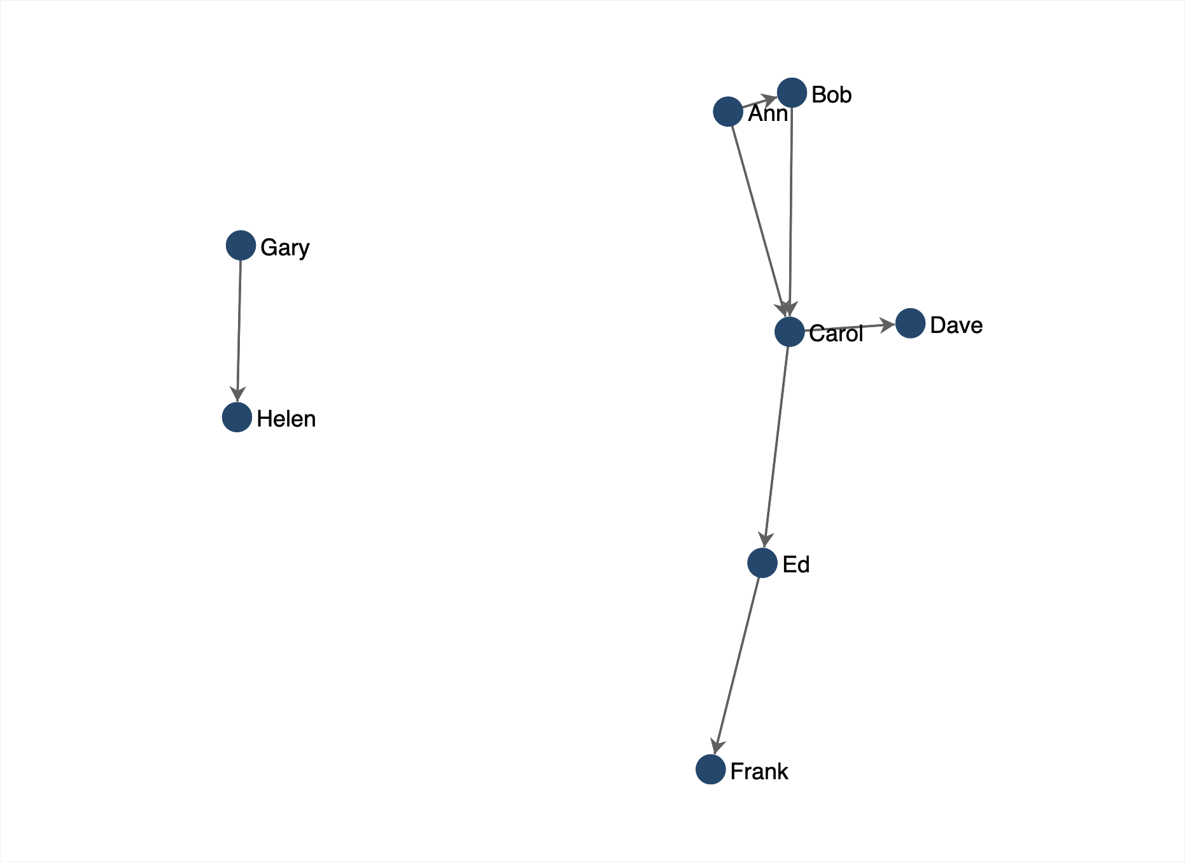
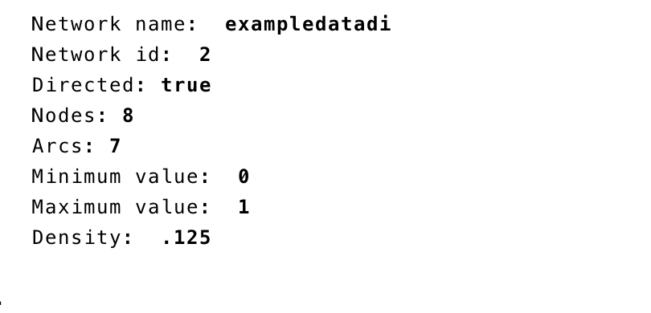
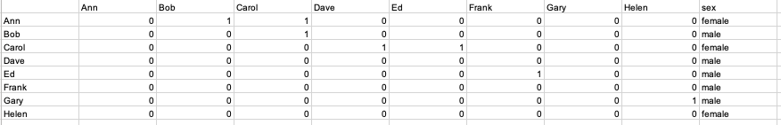
Directed Graph (digraph)

Slide 19
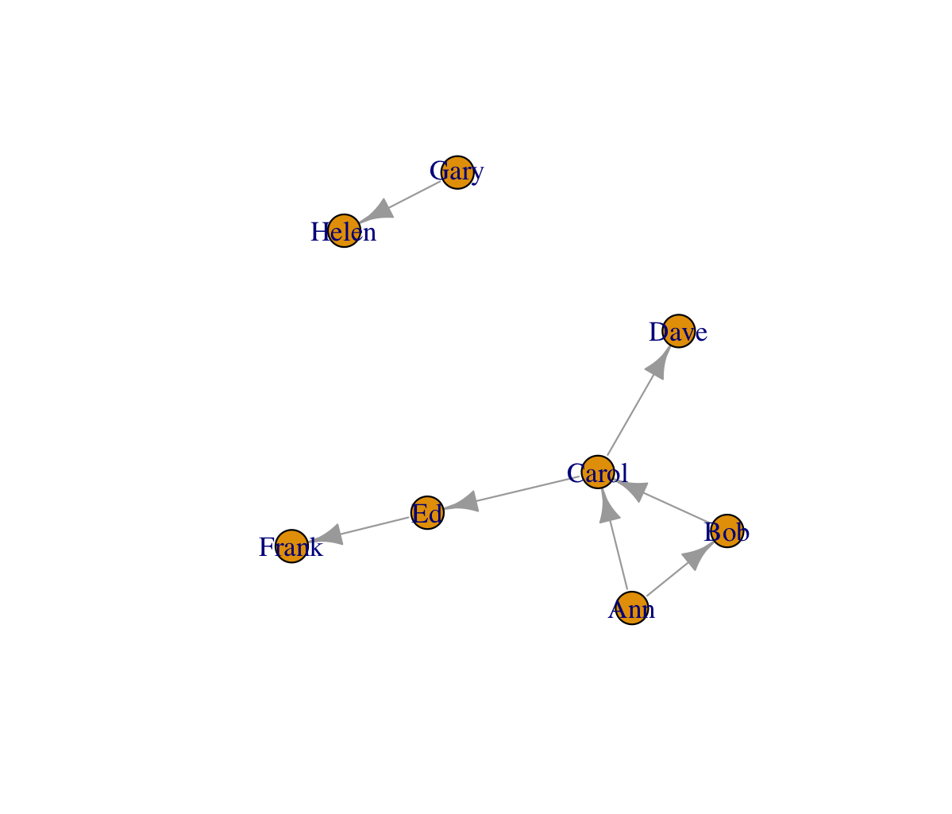
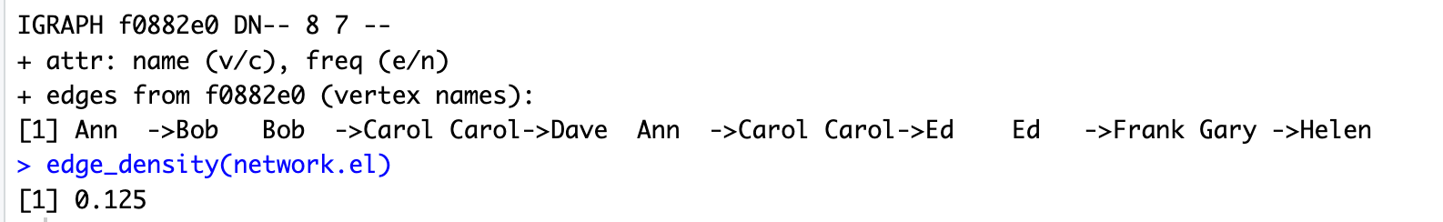
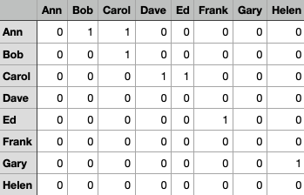
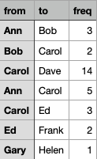
Directed Graph (digraph)

Slide 20


Density
Number of actual ties as proportion of number of possible ties
Probability that a tie exists between any two vertices chosen at random
Di-graph
Undirected
Graph

Slide 21
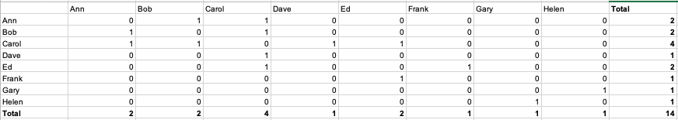

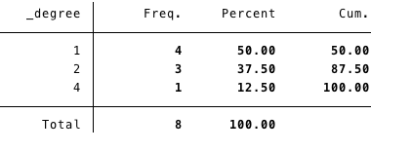
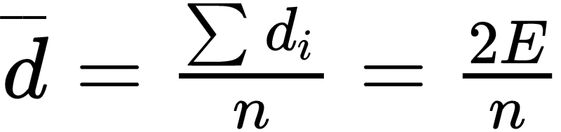


Degree Distribution (undirected)

Slide 22
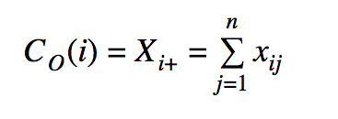
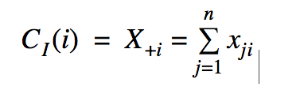
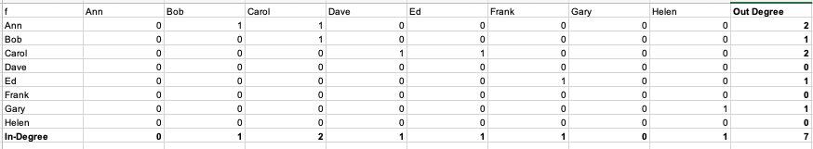
Degree Distribution (digraph)
In-Degree (Popularity)
Out-Degree (Influence??)
Note: Degree is not the sum of in and out degree;
  can not count reciprocal ties twice

Slide 23
Some graph theoretic concepts: Subgraphs
A graph G' = (V', E') is a subgraph of a graph G iff:
  V' is a subset of V and E' is a subset of E
Subgraphs may induced by either:
  Sampling a group of vertices and the selecting the subset of edges that link them
  Sampling a group of edges and the selecting of the vertices that are the destination (origin) of each edge.
A lot of network methods are designed to split a graph into subgraphs
  Subgraphs can be used to represent the social network concepts of groups, cliques, or communities

Slide 24
Walks, Trails, Paths
A walk is an alternating sequence of vertices and edges {u₁, e₁₂, u₂, e₂₃, u₃....u_{n}} starting with an origin vertex u₁ ending with a destination vertex u_{n} such that:
  Each vertex in the sequence (excluding the origin and destination vertices) is adjacent to the vertex the precedes it and the vertex that follows it
The length of the walk is the number of edges contained in the sequence
  A walk is called a path if all edges and all vertices appear only once in the sequence
Graph-theoretic paths can be used to represent the social network concept of “n-degrees of separation” between people
  In particular, we may be interested in the length of the shortest path (L > 1) linking two people

Slide 25
Walks, Trails, Paths
A walk is an alternating sequence of vertices and edges {u₁, e₁₂, u₂, e₂₃, u₃....u_{n}} starting with an origin vertex u₁ ending with a destination vertex u_{n} such that:
  Each vertex in the sequence (excluding the origin and destination vertices) is adjacent to the vertex the precedes it and the vertex that follows it
The length of the walk is the number of edges contained in the sequence
  A walk is called a path if all edges and all vertices appear only once in the sequence
We may also be interested in the average length of the shortest paths (also called geodesics) linking each pair of vertices in a graph
  When this is smaller than we would expect (e.g. “6”) this quantity can be used to represent the social network concept of a “small world”

Slide 26
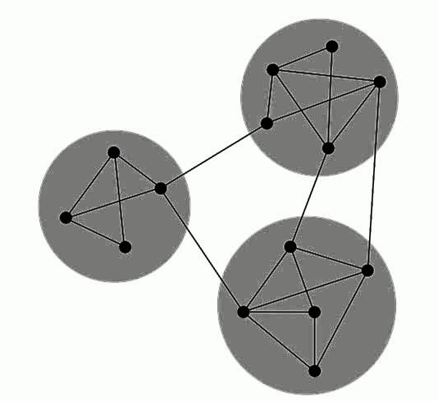
Graph connectivity
A graph is connected if there exists a (finite) path between each vertex
  Otherwise the graph is disconnected
A maximal connected subgraph is called a component
  In a graph, the connected subgraph that contains the largest proportion of vertices is called the giant component

Slide 27
Graph connectivity
A graph is connected if there exists a (finite) path between each vertex
  Otherwise the graph is disconnected
A maximal connected subgraph is called a component
  In a graph, the connected subgraph that contains the largest proportion of vertices is called the giant component
Oops! Disconnected!

Slide 28
Graph connectivity
A graph is connected if there exists a (finite) path between each vertex
  Otherwise the graph is disconnected
A maximal connected subgraph is called a component
  In a graph, the connected subgraph that contains the largest proportion of vertices is called the giant component

Slide 29
Graph connectivity
A graph is connected if there exists a (finite) path between each vertex
  Otherwise the graph is disconnected
A maximal connected subgraph is called a component
  In a graph, the connected subgraph that contains the largest proportion of vertices is called the giant component

Slide 30
Graph connectivity
Some graphs are easy to disconnect
  Only require the removal of a few links
Others are hard to disconnect
  Requires the removal of a lot of links
The number of edges whose removal is required to disconnect a graph can represent the social network concept of social integration
  This is called the cutset

Slide 31
Graph connectivity
Some graphs are easy to disconnect
  Only require the removal of a few links
Others are hard to disconnect
  Requires the removal of a lot of link
The higher the cutset the more integrated the social network
The lower the cutset the more potentially fragmented the social structure is

Slide 32

Weighted graphs
Often it is useful to associate numerical values with the edges (uv) of a graph:
  This is called the edge weight (w_{uv})
  This may be used to represent:
    the strength of the relationship joining two people
    the amount of something (e.g. information) that flows via the ties
Graphs that featured edge weights are called weighted (valued) graphs:
  Binary graphs can be thought of as a constrained case of weighted graphs

Slide 33
Weighted graphs
Often it is useful to associate numerical values with the edges (uv) of a graph:
  This is called the edge weight (w_{uv})
  This may be used to represent:
    the strength of the relationship joining two people
    the amount of something (e.g. information) that flows via the ties
Sometimes people “binarize” weighted graphs using a cutoff to simplify analysis
  a_{ij} = 1 if w_{ij} > ϴ, else a_{ij} = 0

Slide 34
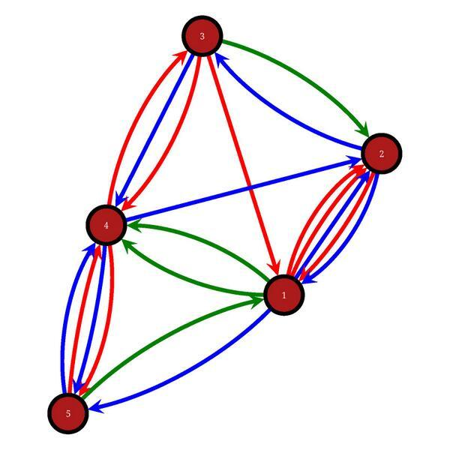
Multigraphs
In both directed and undirected graphs, the same vertices may be joined by more than one distinct edge
  These are called multigraphs
Multigraphs may be used to represent the social network concept of multiplexity
Multiplexity exist when persons have multiple relations relationships with one another
    e.g. a friend who is also an advisor who is also a member of your congregation

Slide 35
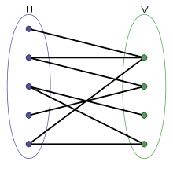
Bipartite graphs
A bipartite graph is characterized by:
  Two disjoint sets of vertices.
  Edges link vertices between sets but not within sets
Bipartite graphs can be used to represent the social network concepts of affiliation or membership
  In Affiliation networks people are linked to other entities that are not people
    Actors and movies
    Scientists and papers
    Persons and events

